Slide 1


SMART INDIA HACKATHON 2025
TITLE PAGE
Problem Statement ID – SIH25023
Problem Statement Title- AyurSutra- Panchakarma patient Management and therapy scheduling Software
Theme- MedTech/ BioTech/ HealthTech
PS Category- Software
Team ID- 54822
Team Name- CHARMANDER

Slide 2

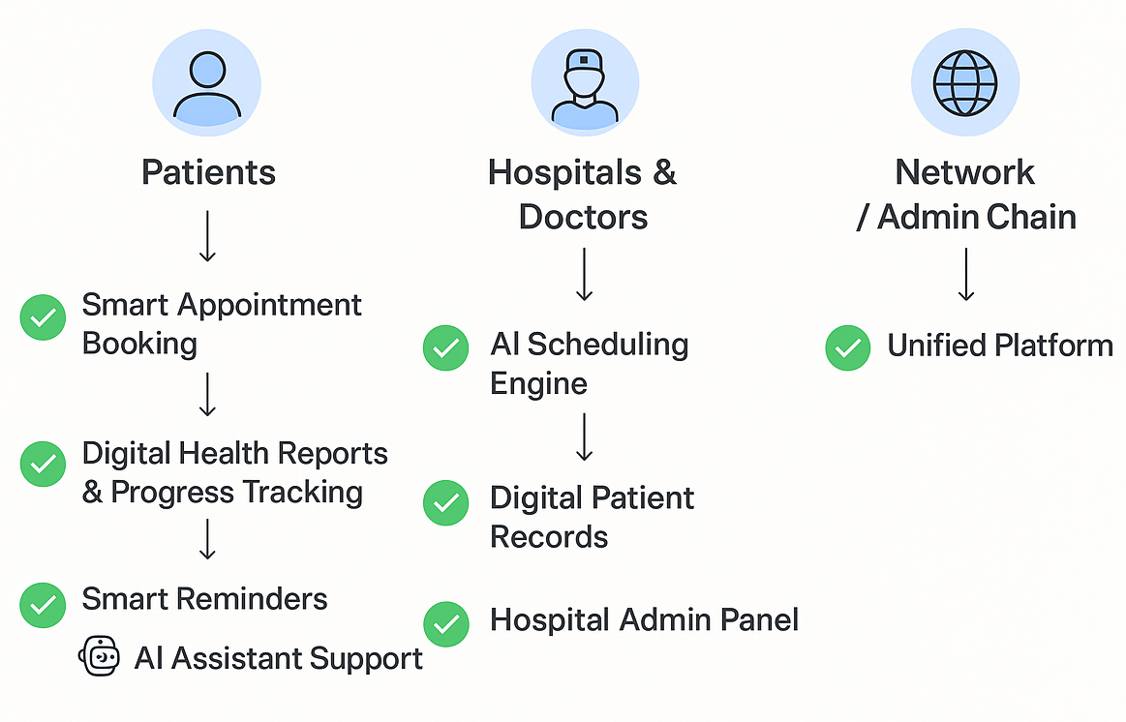
AyurSutra: AI-Powered Digital Ayurveda Ecosystem
CHARMANDER
Patients | Hospitals & Doctors | Network / Admin Chain
Smart Appointment Booking – Smart Appointment Booking – Find the nearest center, check doctor availability, and book appointments easily through the app, powered by both manual input and AI assistance. | AI Scheduling Engine – Doctor on leave → AI redistributes slots; Traveling patient → session auto-rescheduled | 🌐 Unified Platform – Connects all centers → data sharing, tele-consultation, nationwide expansion
Digital Health Reports & Progress Tracking – Track therapy journey with AI dashboards; automatically updates patient progress | Digital Patient Records – Access complete patient history in one secure dashboard with monthly analysis
Smart Reminders – Automated notifications & emails for sessions, lifestyle guidance, medicines | Hospital Admin Panel – Manage doctors, staff, patients, therapy schedules easily; AI can auto-assign tasks monthly analysis report
AI Assistant Support – Personal AI assistant guides, answers questions, handles routine queries via prompt; replaces manual explanation

Slide 3
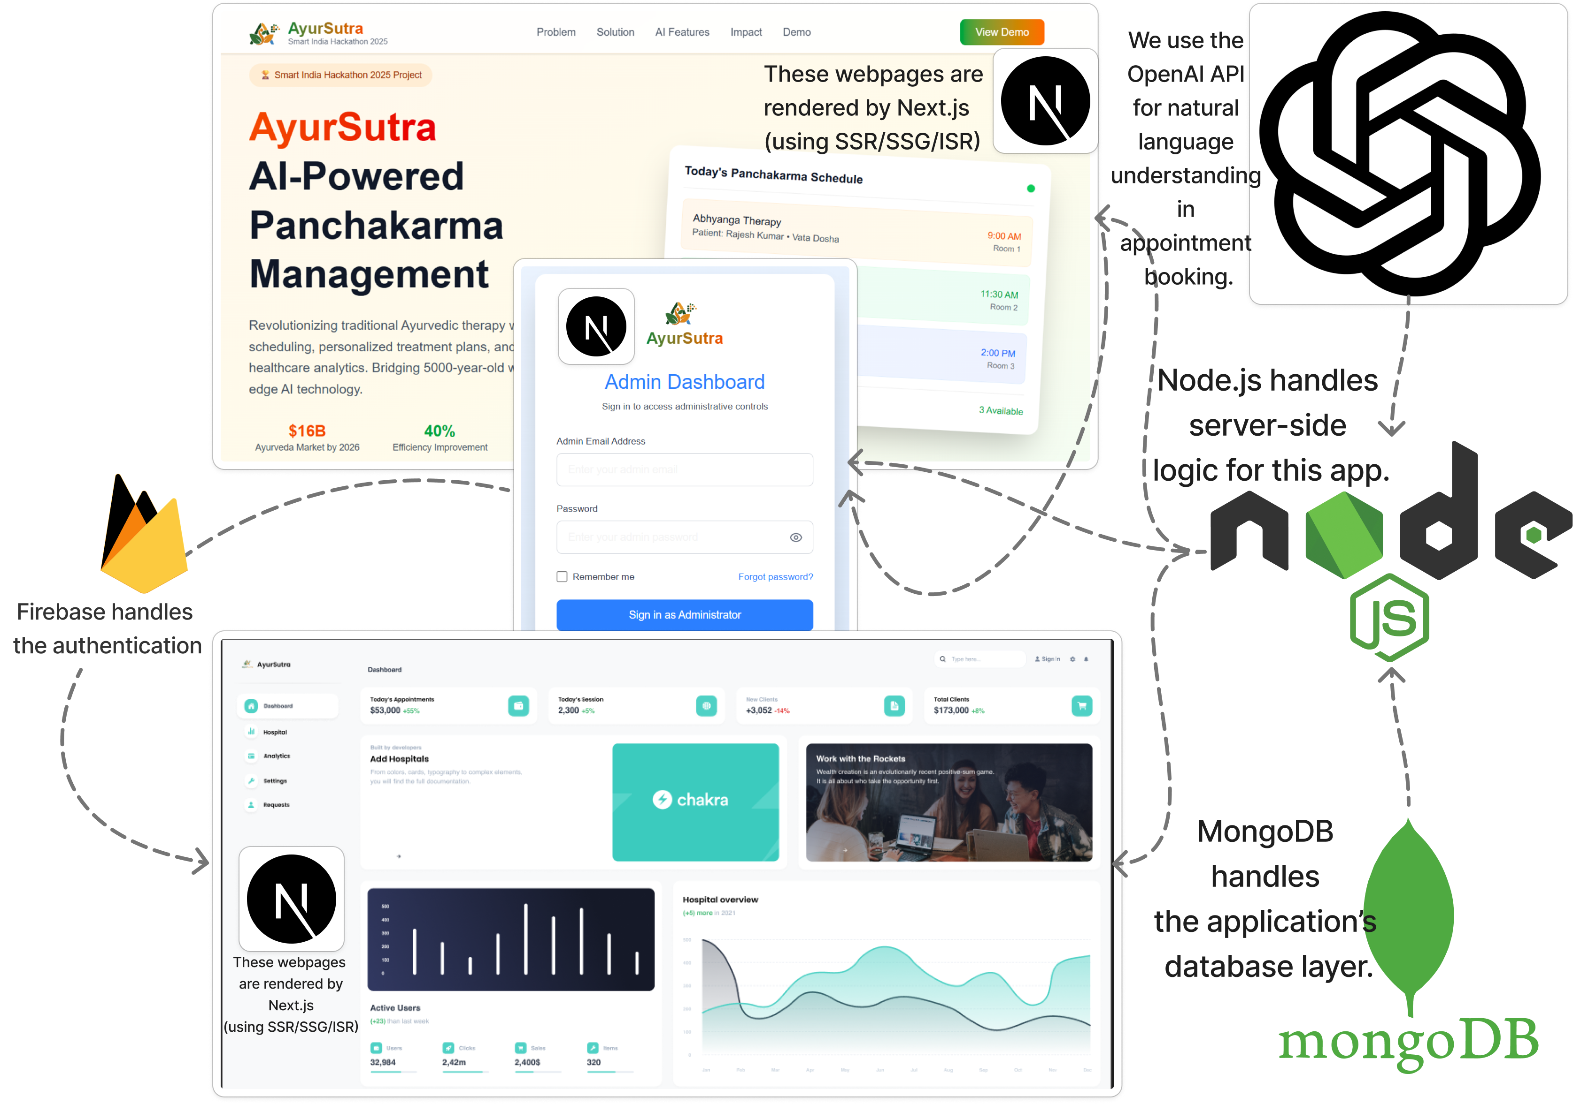





TECHNICAL APPROACH
CHARMANDER
Technologies to be used :
Next.js
Node.js
MongoDB
Firebase
OpenAI api
`

Slide 4
FEASIBILITY AND VIABILITY
CHARMANDER
Analysis of the feasibility of the idea
Potential challenges and risks
Strategies for overcoming these challenges
Proven, popular tech stack (Next.js, Node.js, MongoDB, Firebase)
AI integration via OpenAI APIs is feasible
Modular, scalable system design
Digital therapy scheduling aligns with practice needs
User feedback loop allows iterative improvements
Secure data storage and access control
AI scheduling accuracy and adaptability
Resistance to digital adoption in traditional centers
Complexity integrating AI, patient, doctor modules
Achieving user trust and comfort with AI decisions
Continuous system uptime and maintenance
Start with rule-based scheduling, enhance with AI over time
Conduct training and involve Panchakarma experts early
Build modular components, test extensively
Transparent AI alerts and manual override options
Cloud provider SLAs and multi-region deployment

Slide 5
IMPACT AND BENEFITS
CHARMANDER
3. Health Benefits
Achieves 25–30% stress reduction.
Boosts immunity by 20%.
Ensures holistic health improvement (mind–body balance).
4. Technological Benefits
Provides 24/7 digital access.
Offers personalized AI-driven wellness plans.
Tracks progress with real-time analytics.
5. Environmental Benefits
Encourages eco-friendly, natural remedies.
Minimizes paperwork via digital records.
Promotes a sustainable lifestyle.
Potential impact on the target audience:
Cost Savings : 40–60% reduction in cost compared to physical Panchakarma consultations.
Retention : Reminders and trackers boost retention by 45% compared to non-digital methods.
Lifestyle : Daily app usage leads to 30% improvement in healthy lifestyle adoption.
Motivation : App modernizes Ayurveda, making it +50% more appealing to youth & professionals.
Health Outcomes : 20% improvement in immunity and body balance markers with guided digital support.
Benefits of the solution :
1. Social Benefits
Promotes Ayurveda awareness and traditional wellness.
Builds a digital wellness community.
Enhances accessibility for rural and urban users.
2. Economic Benefits
Delivers 40–60% cost savings on consultations.
Reduces healthcare spending through preventive care.
Expands Ayurveda & wellness tourism market (16% CAGR).
Benefits of the solution
SOCIAL
ENVIRONMENTAL
ECONOMIC
TECHNOLOGICAL
HEALTH

Slide 6
RESEARCH AND REFERENCES
CHARMANDER
RESEARCH AND COMPARISON WITH EXISTING SYSTEMS
FEATURES |  | Appointment Booking | Electronic Records (EMR) | AI Personalization | Educational Content | Reminders & Alerts | Doctor/Expert Profiles | Payments & Subscriptions | Target Audience Coverage
CHARMANDER |  | ✅ | ✅ | ✅ | ✅ | ✅ | ✅ | ✅ | ✅
1Ayurved |  | ✅ | ❌ | ❌ | ❌ | ❌ | ✅ | ✅ | ❌
Drlogy |  | ❌ | ✅ | ❌ | ❌ | ✅ | ❌ | ✅ | ❌
NirogStreet/VedaPulse |  | ❌ | ❌ | ✅ | ❌ | ❌ | ✅ | ❌ | ❌
Amrit e-Map/AyurCel |  | ❌ | ❌ | ❌ | ✅ | ❌ | ❌ | ❌ | ❌
REFERENCES
FEASIBILITY FACTS:
https://www.futuremarketinsights.com/reports/ayurvedic-products-and-treatment-market
https://english.mathrubhumi.com/features/health-archives/national-ayush-mission-to-promote-panchakarma-treatment-centres-and-medical-value-tourism-projects-eeb35b31
RESEARCH LINKS :
https://www.ayurvedjournal.net/archives/2025/vol2issue2/PartA/2-2-9-665.pdf
https://fastercapital.com/content/Ayurvedic-Innovation-and-Technology--The-Digital-Revolution-in-Ayurveda--Exploring-Cutting-Edge-Technological-Applications.html
https://www.researchgate.net/publication/383060968_Artificial_intelligence_in_Ayurveda_Current_concepts_and_prospects
PLATFORMS FOR COMPARISON :
1Ayurved: https://1ayurved.com/
Drlogy : https://www.drlogy.com/
NirogStreet : https://www.crunchbase.com/organization/nirogstreet
AyurCel : https://ayurcel.org/
Prototype
https://ayursutra-prototype-omega.vercel.app
UNDERSTANDING THE PROBLEM STATEMENT
REQUIREMENT ANALYSIS
LITERATURE REVIEW
TESTING AND EVALUATION
DESIGN AND IMPLEMENT PROPOSED SOLUTION
COMPARE WITH EXISTING SYSTEMS
WORKFLOW DIAGRAM OF RESEARCH WORK

